Slide 1
SMALL ARMS

Slide 2
SMALL ARMS
Learning Objectives
Describe small arms ammunition and associated size designations.
Identify and describe small arms ammunition components
Recognize and describe types of small arms ammunition.
Identify and describe general requirement for small arms ammunition marking and color coding.
Describe the types and uses of packaging configurations for small arms ammunition.
Evaluate safety precautions inherent to small arms ammunition.
Utilize the TM 43-0001-27, Datasheets for Small Arms Ammunition, for familiarization and identification of ammunition items

Slide 3
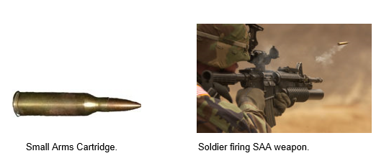
SMALL ARMS
Small Arms Ammunition
Small arms ammunition (SAA) consists of a cartridge or family of cartridges ranging in size from .22 caliber through 30MM. SAA cartridges are intended for various types of handheld or mounted weapons including rifles, pistols, revolvers, machine guns, and shotguns.
SAA cartridges are designated by FSC 1305, with the exception of grenade cartridges which are FSC 1330.

Slide 4
SMALL ARMS
The U.S. military maintains stocks of various size designations of small arms ammunition, which are classified by the terms caliber and gauge.
Small arms ammunition may be designated in size by caliber. The term caliber refers to the inside diameter of a weapon barrel, commonly referred to as the weapon bore. Caliber is expressed in millimeters (e.g. Cartridge 5.56MM) or in decimal fractions of an inch (e.g. Cartridge, Caliber .22). Read Foreign SAA for more information on size designations for small arms ammunition produced in countries other than the U.S.
Example: SAA designated as Cartridge, Ball, 7.62MM would have a bore diameter of 7.62MM and an item designated as Cartridge, Caliber .22 would have a bore diameter of .22 inches.

Slide 5
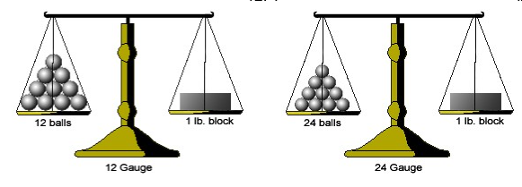
SMALL ARMS
Gauge
SAA designated in size by gauge are exclusively used in shotguns and are measured by the diameter of the shotgun barrel. The gauge of an SAA item more specifically identifies the number of lead balls (with an equivalent diameter to the bore) that would be required to weigh one pound.
Example: A 24-gauge shotgun has a smaller bore diameter than a 12-gauge shotgun since it would require 24 lead balls of that bore diameter to equal one pound, whereas a 12-gauge shotgun would only require 12. This principle is illustrated by the scales in the

Slide 6
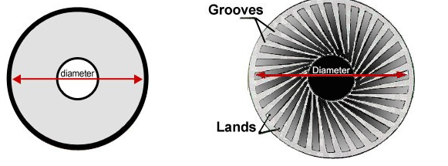
SMALL ARMS
Weapon Bore Classifications
Weapon barrel may be referred to as weapon bore in many publications. A weapon bore may be described as having a smooth bore or rifled bore. Shotguns typically use smooth bore weapons while other SAA use rifled bore weapons.
The barrel of a smooth bore weapon has a relatively flat, smooth surface. Rifled bore weapons, on the other hand, contain lands and grooves on the interior of the weapon barrel. The lands are raised edges in the bore and the grooves are flat surfaces. The diameter of a rifled bore weapon is measured from land to land.

Slide 7
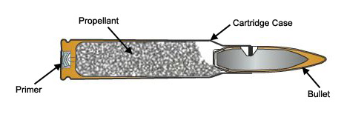
SMALL ARMS
Major Components
SAA items may vary by size, designation, and bore type, but they all consist of the following four major components:
Bullet (projectile)
Cartridge Case
Propellant
Primer
The image below depicts a standard SAA cartridge as well as the four major components.

Slide 8
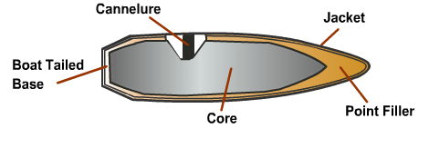
SMALL ARMS
Bullet
Bullet is a common term for a small arms projectile. The bullet is the component of the cartridge that is propelled from the weapon towards the intended target. The bullet often consists of the subcomponents identified in the animation below.
Bullet SAA Components

Slide 9
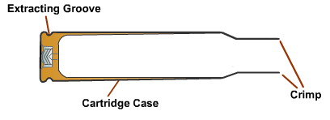
SMALL ARMS
Cartridge Case
The cartridge case holds the propellant, primer, and the bullet. The animation below depicts a common SAA cartridge case.

Slide 10
SMALL ARMS
Propellant
The burning gases produced from the propellant in a SAA cartridge propels the bullet towards the intended target.
SAA cartridge cases are loaded with various propellant weights that impart sufficient velocity, within safe pressure, to obtain required ballistic projectile performance. The propellant for SAA is of single-base or double-base composition.
SAA propellant grains may be single-cylindrical or multiple-perforated, ball, or flake. Propellant grains are loaded loosely inside the cartridge case.

Slide 11
SMALL ARMS
Primer
The primer of a SAA cartridge initiates the propellant. SAA primers may be of either electric or percussion type. Electric primers are initiated by an electric current while percussion primers are initiated by the impact of a firing pin.

Slide 12
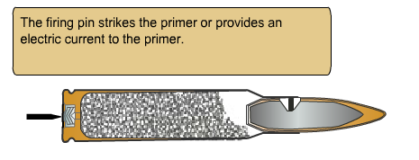
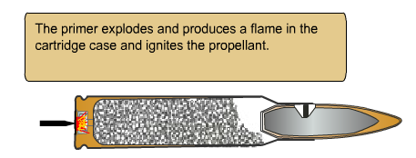
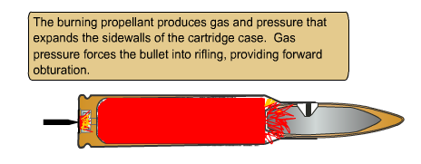
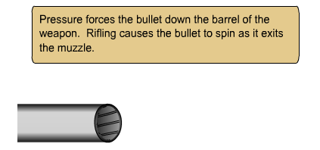
SMALL ARMS
SAA Explosive Train

Slide 13
SMALL ARMS
Ball Cartridge
The ball cartridge is intended for use in rifles, carbines, pistols, revolvers, and/or machine guns against personnel and unarmored targets. The bullet, as designed for general purpose combat and training requirements, normally consists of a metal jacket and a lead slug.
Caliber .50 ball bullet and 7.62MM, Ball M59 bullet contain soft steel cores. Cartridge 5.56MM Ball M855 is now being manufactured with lead free bullets to meet environmental standards. These rounds are commonly referred to as "green ammo" and are currently restricted to use only on ranges with mandatory environmental constraints.

Slide 14
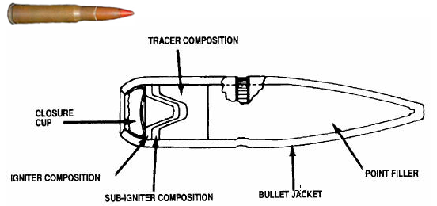
SMALL ARMS
Tracer (T) Cartridge
A tracer round contains a pyrotechnic composition in the base of the bullet to permit visible observation of the bullet's in-flight path or trajectory and point of impact. The pyrotechnic composition is ignited by the propellant when the round is fired emitting a bright flame visible by the gunner. Tracer rounds may also be used to pinpoint enemy targets. They are used to ignite flammable materials and for signaling purposes.

Slide 15
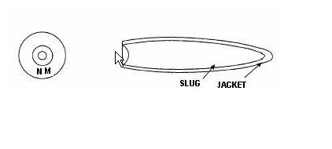
SMALL ARMS
Match (MATCH) Cartridge
Match cartridges are high-quality rounds specifically manufactured for shooting competitions. Match cartridges can be of any size designation. The bullet consist of a gilded metal jacket and lead slug. The cartridges are identified on the head face with the designation NM (National Match) or Match.

Slide 16
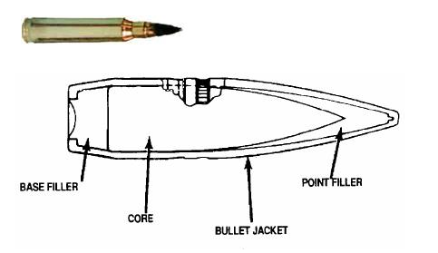
SMALL ARMS
Armor-Piercing (AP) Cartridge
The armor-piercing cartridge (AP) is intended for use in machine guns or rifles against personnel and light armored and unarmored targets, concrete shelters, and similar bullet-resistant targets. The bullet consists of a metal jacket and a hardened steel-alloy core. In addition, it may have a lead base filler and/or a lead point filler.

Slide 17
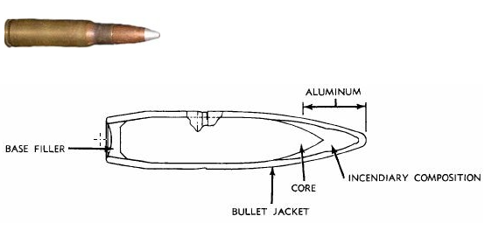
SMALL ARMS
Armor-Piercing Incendiary (API) Cartridge
The armor-piercing incendiary (API) cartridge is used in rifles or machine guns as a single combination cartridge in lieu of separate armor-piercing and incendiary cartridges. The bullet is similar to the armor-piercing bullet, except that the point filler is incendiary mixture instead of lead. Upon impact with the target, the incendiary mixture bursts into flames to ignite combustible/flammable targets (i.e. vehicle and aircraft fuel tanks).

Slide 18
SMALL ARMS
Armor-Piercing Incendiary Tracer (API-T) Cartridge
The bullet of the armor-piercing incendiary tracer (API-T) cartridge combines the features of the armor-piercing, incendiary, and tracer bullets. The bullet consists of a hard steel core with compressed pyrotechnic mixture in the cavity at the base of the core. The core is covered by a gilded metal jacket with incendiary mixture between the core point and jacket.

Slide 19
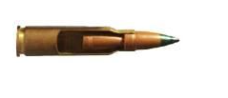
SMALL ARMS
Duplex Cartridge
The duplex cartridge contains two special ball-type bullets in tandem. The front bullet is positioned in the case neck (similar to a standard ball round) and the rear bullet is positioned in the case and is held in place by the propellant. The base of the rear bullet is angled so that in flight it follows a path slightly dispersed from that of the front bullet.

Slide 20
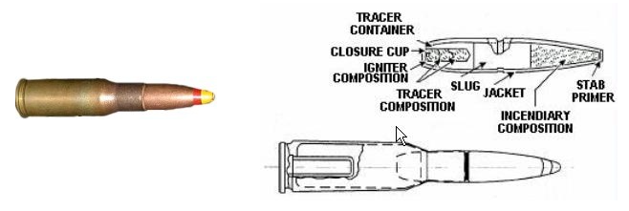
SMALL ARMS
Spotter-Tracer Cartridge
The spotter-tracer (ST) cartridge is used in Caliber .50 spotting rifles to serve as a fire control device to verify weapon sight settings for 106MM weapons. The bullet trajectory of this cartridge closely approximates that of a 106MM projects. The bullet contains an impact detonator, incendiary composition, and tracer composition to identify the point of impact with a flash and smoke.

Slide 21
SMALL ARMS
Blank Cartridge
The blank cartridge is distinguished by the absence of a bullet. It is used for simulated fire, in training maneuvers, and for saluting purposes. These rounds consist of a roll crimp (knurl) or cannelure on the body of the case, which holds a paper wad in place instead of a bullet. Newer cartridges have rosette crimp (7 petals) and an identification knurl on the cartridge case

Slide 22
SMALL ARMS
Blank Cartridge
The blank cartridge is distinguished by the absence of a bullet. It is used for simulated fire, in training maneuvers, and for saluting purposes. These rounds consist of a roll crimp (knurl) or cannelure on the body of the case, which holds a paper wad in place instead of a bullet. Newer cartridges have rosette crimp (7 petals) and an identification knurl on the cartridge case

Slide 23
SMALL ARMS
Grenade Cartridge
The grenade cartridge is used to propel rifle grenades and ground signals from launchers attached to rifles or carbines. Rifle grenade cartridges are blank cartridges distinguished by the rose petal (rosette crimp) closure at the mouth of the case. Grenade cartridges are assigned to FSC 1330.

Slide 24
SMALL ARMS
Frangible Cartridge
These cartridges are designed for target practice. The bullet is made of powdered lead and friable plastic that disintegrates upon impact with the target. Inhalation of bullet dust can be toxic and requires use in well ventilated ranges. The .30 caliber frangible cartridge is designed for aerial target training purposes. It can also be used in rifles and machine guns for target shooting. Caliber .30 and 7.62MM frangible cartridges are used in tank machine guns for training in tank gunnery. At its normal velocity, the bullet, which is composed of powdered lead and friable plastic, will completely disintegrate upon striking a 3/16-inch aluminum alloy plate at 100 yards from the muzzle of the gun. These cartridges are not to be used on any but well ventilated indoor ranges to preclude buildup of toxic bullet dust. Inhalation of bullet dust may be injurious to health.

Slide 25
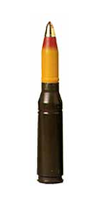
SMALL ARMS
High-Explosive Incendiary (HEI) Cartridge
The high-explosive incendiary cartridge is a combat round used on aircraft and ground vehicles. It contains a projectile consisting of a steel body and point-detonating fuze. The steel body contains a high-explosive incendiary mixture, which is detonated on impact as the fuze strikes the target. The fuze is a high-percussion device that arms shortly after leaving the muzzle of the weapon. Upon impact, the fuze releases a small firing pin which sets off the charge in the fuze and detonates the round.

Slide 26
SMALL ARMS
High-Explosive Incendiary (HEI) Cartridge
The high-explosive incendiary cartridge is a combat round used on aircraft and ground vehicles. It contains a projectile consisting of a steel body and point-detonating fuze. The steel body contains a high-explosive incendiary mixture, which is detonated on impact as the fuze strikes the target. The fuze is a high-percussion device that arms shortly after leaving the muzzle of the weapon. Upon impact, the fuze releases a small firing pin which sets off the charge in the fuze and detonates the round.

Slide 27
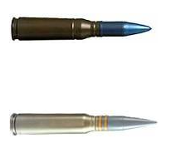
SMALL ARMS
Target Practice (TP) and Target-Practice Tracer (TP-T) Cartridge
The target-practice-tracer (TP-T) cartridge contains a target-practice projectile with a tracer cavity. The cavity is filled with pyrotechnic composition and is located in the rear of the body. This cartridge is generally linked with the target-practice cartridge in a ratio of 1-to-7.
The target-practice (TP) cartridge contains a hollow or solid inert projectile with an aluminum or steel nose. It is used primarily for training purposes.

Slide 28
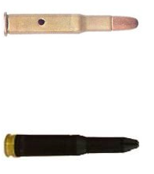
SMALL ARMS
Dummy/Inert-Loaded Cartridge
The dummy cartridge is used for practice in loading weapons and simulated firing to detect flinching of personnel when firing weapons. This round is completely inert and consists only of an empty cartridge case and a ball bullet. Cartridge identification is by means of holes through the side of the case or longitudinal corrugations in the case and by the empty primer pocket.
The dummy-inert loaded cartridge consists of a cartridge case, a ball bullet, and inert granular material in the case simulating the weight and balance of a live cartridge. The exterior of the cartridge is identified by a black chemical finish and by the absence of a primer. This cartridge is used by installations for testing weapon function, linkage, and feed chutes.

Slide 29
SMALL ARMS
Subcaliber Cartridge
Subcaliber rounds are fired from subcaliber barrels inserted into larger weapons for training purposes. For example, a 22MM subcaliber cartridge is used in an 81MM training device to simulate the firing of 81MM mortar ammunition during training. Use of subcaliber ammunition is cost effective for the Army because the training device can be reused. Training with live ammunition is not only expensive, but it also raises safety concerns.

Slide 30
SMALL ARMS
Special Purpose Cartridge
Examples of special purpose SAA include high-pressure test cartridges used for proof firing of weapons at the manufacturer (not for field use, test use only); wad-cutter cartridges for target practice; line-throwing cartridges used by the Navy to throw lines from ship to ship or by the Army to project signal wires over elevated terrain.

Slide 31
SMALL ARMS
Depleted Uranium Cartridge
Due to their larger size, small arms ammunition ranging in size from 20MM through 30MM contain some additional components not seen on other small arms discussed thus far. All 20MM, 30MM, and some 25MM projectiles are assemblies of a steel shell containing a brass rotating band and a point-detonating nose fuze or aluminum, steel, or plastic nose plug. With a few exceptions, cartridges within this size range contain an electric primer.
Certain AP rounds contain a depleted uranium (DU) penetrator to enhance their armor defeating capabilities. DU is a heavy metal that has a very low level of radioactivity. Although its activity is much lower than the natural Uranium found in soil, it is still regulated by an NRC (Nuclear Regulatory Commission) license. This means certain restrictions will apply to the storage, use, and disposal of these munitions. They are only issued for combat use. Test firings are limited to specifically authorized ranges and routine demilitarization by burning or detonation is prohibited.

Slide 32
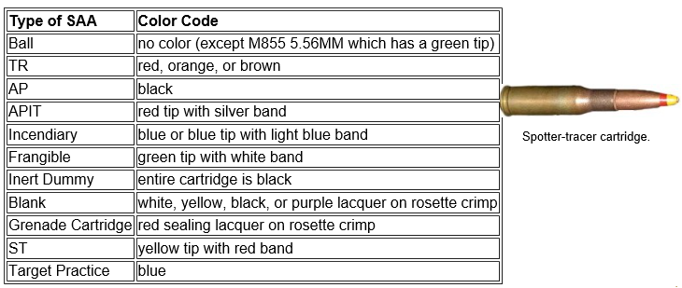
SMALL ARMS
SAA Color Coding
Small arms ammunition is identifiable by color coding specifications per type and intended use. The table below identifies color code specifications (as applied to the tip of the bullet) for the various types of SAA.

Slide 33
SMALL ARMS
SAA Markings (smaller than 20MM)
Small arms ammunition smaller than 20MM have markings stamped on the face of the cartridge case surrounding the primer, commonly known as the headstamp. Headstamp markings include the following as illustrated on the image of the headstamp below:
Manufacturer's initials/symbol
Year of manufacture
NATO symbol
MATCH or NM as applicable

Slide 34
SMALL ARMS
SAA Markings (smaller than 20MM)
Small arms ammunition smaller than 20MM have markings stamped on the face of the cartridge case surrounding the primer, commonly known as the headstamp. Headstamp markings include the following as illustrated on the image of the headstamp below:
Manufacturer's initials/symbol
Year of manufacture
NATO symbol
MATCH or NM as applicable

Slide 35
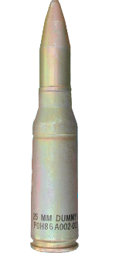
SMALL ARMS
SAA Markings (20MM and larger)
Markings on small arms ammunition items 20MM and larger are stenciled on the side of the cartridge case. These markings include:
Nomenclature (size, type, and model number)
Lot number

Slide 36
SMALL ARMS
Configurations
SAA packaging configurations usually include a combination of outer and inner packaging. Packaging is usually stenciled with markings to identify contents for storage, transportation, and handling.
General packaging requirements are outlined in the TM 9-1300-200 and SW010-AD-GTP-010. Specific packaging requirements for all SAA items can be found in the TM 43-0001-27, Datasheets for Small Arms Ammunition

Slide 37
SMALL ARMS
Outer Packaging
SAA outer packaging consists of wirebound boxes, metal cans, and plastic cans.
Wirebound boxes are the typical outer packaging for the smaller calibers of small arms ammunition. They are made of wood and reinforced with wire to handle the weight of its contents.
Metal and plastic cans are the typical outer packing for larger calibers of small arms ammunition (e.g. 20MM).

Slide 38
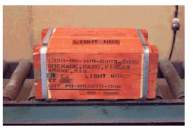
SMALL ARMS
Light Boxes
Wooden/wirebound boxes with less than their full issued quantity remaining are called light boxes. No more than one light box is allowed per lot of SAA. More information about special precautions for light boxes can be found in MIL-STD-129.
Note: Light boxes of small arms ammunition must be appropriately marked and rounds must be secured in the box with inner packaging and filler material.
Light boxes are visible by their orange painting as illustrated in the image below.

Slide 39
SMALL ARMS
Inner Packaging
Inner packaging for small arms ammunition items may include:
Links
Clips
Cardboard cartons
Bandoleers
Magazines
Metal cans

Slide 40
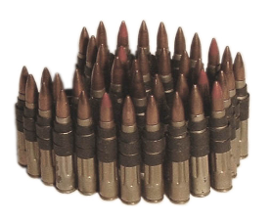
SMALL ARMS
Links
Links are used to assemble cartridges into belts which feed into a machine gun. Links usually contain 100-750 cartridges per belt. Ball and tracer linked SAA may be referred to as a functional pack.
Paragraph 3-19 of TM 9-1300-200 provides more information on links as SAA packaging.

Slide 41
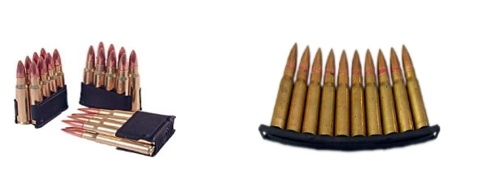
SMALL ARMS
Clips
Clips are three or more cartridges assembled together. They are used to facilitate the transfer of cartridges to a magazine or receiver on a rifle.

Slide 42
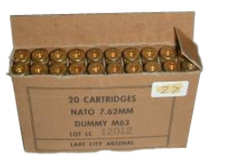
SMALL ARMS
Cardboard Cartons
Individual rounds may be packaged inside cardboard cartons. Cardboard cartons provide a means for consolidating cartridges into other packaging.

Slide 43
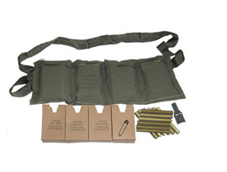
SMALL ARMS
Bandoleers
Cartons, magazines, or clips can be easily carried by troops in a cloth pouch known as a bandoleer.

Slide 44
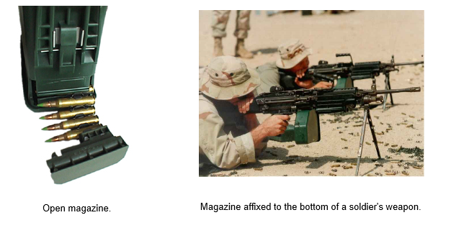
SMALL ARMS
Magazines
A magazine allows for easy loading or feeding of cartridges into a weapon.

Slide 45
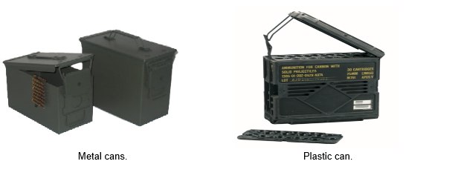
SMALL ARMS
Metal and Plastic Cans
Cardboard cartons, bandoleers, and linked ammunition are typically packaged inside metal or plastic cans. Metal cans vary in size and can be used as inner or outer packaging.
Both cans contain a rubber gasket around the inside of the lid to prevent moisture from entering the can.

Slide 46
SMALL ARMS
Using SAA Datasheets
The TM 43-0001-27, Datasheets for Small Arms Ammunition, is a publication that serves as an aid in planning, training, familiarization, and identification of small arms ammunition. For each item of materiel in the TM 43-001-27, there are illustrations and descriptions with characteristics and related data. Included in the related data are weights, dimensions, performance data, shipping and storage data, and type classification.

Slide 47
SMALL ARMS
SAA Safety
Safety precautions inherent to small arms ammunition have been established to protect personnel, soldiers, and civilians during storage, transportation, and handling.
On the following pages, you will learn some of the general safety precautions inherent to small arms ammunition. Safety precautions for Army-specific items are found in TM 43-0001-27, Datasheets for Small Arms Ammunition, while Navy-specific items can be found in SW010-AD-GTP-010, Small Arms and Special Warfare Ammunition.

Slide 48
SMALL ARMS
Special Precautions
The following special precautions must be followed when transporting, storing, or handling small arms ammunition items.
Whenever practical, store small arms ammunition under cover. This applies particularly to tracer and shotgun ammunition.
Never use oil or grease on small arms cartridges. Oil or grease might produce excessive and hazardous chamber pressures in weapons when fired and cause damaging abrasives to collect in automatic weapons.
Segregate stored ammunition by caliber, type, and ammunition lot.
Conductive safety shoes, grounded floor mats, and work tables are required when handling unpacked SAA with electric primers.

Slide 49
SMALL ARMS
Firing Precautions
Precautions to be taken during the firing and handling of SAA in the field are specifically prescribed in AR 385-63 (Range Safety), TM 9-1300-206 (Ammunition and Explosives Standards), and TM 43-0001-27 (SAA Datasheets). The following general precautions should also be observed.
Do not fire cartridges which have been damaged or perforated or those that have loose bullets or projectiles.
Never use armor-piercing (AP, API, or API-T) ammunition in training demonstrations involving manned tanks and vehicles.
Do not fire ammunition until it has been identified by ammunition lot number and any suspensions or restrictions have been verified.

Slide 50
Questions

